Slide 1
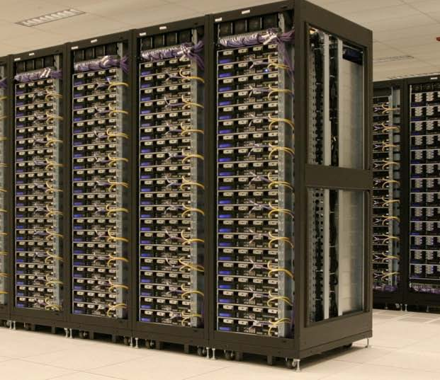
IST3134 – Hadoop Ecosystem and More MapReduce
This Photo by Unknown Author is licensed under CC BY-SA-NC

Slide 2

This week’s padlet….
https://sunwayeducationgroup.padlet.org/sianlunl/2024_ist3134_w4_6

Slide 3

What do you remember about Hadoop?

Slide 4
What is Apache Hadoop
A software framework for storing, processing, and analyzing “big data”
Distributed
Scalable
Fault-tolerant
Open source

Slide 5
Core Hadoop Concepts
Applications are written in high-level code
Developers do not need to worry about network programming, temporal dependencies or the low-level infrastructure
Nodes communicate with one another as little as possible
And developers also do not need to instruct the communication between nodes
“Share nothing” architecture
Data is not only spread among the machines in advance
But computation also should only take place at where the data is stored
To enable better availability and reliability, data is also REPLICATED multiple times in the system

Slide 6
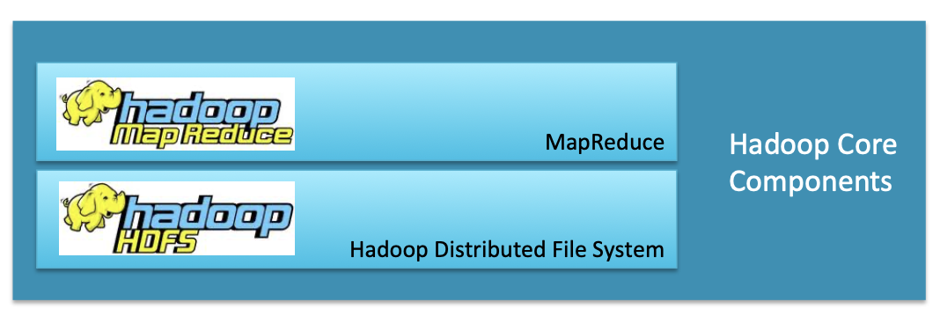
Recap: Hadoop Core Components
Hadoop consists of two core components
The Hadoop Distributed File System (HDFS)
MapReduce

Slide 7
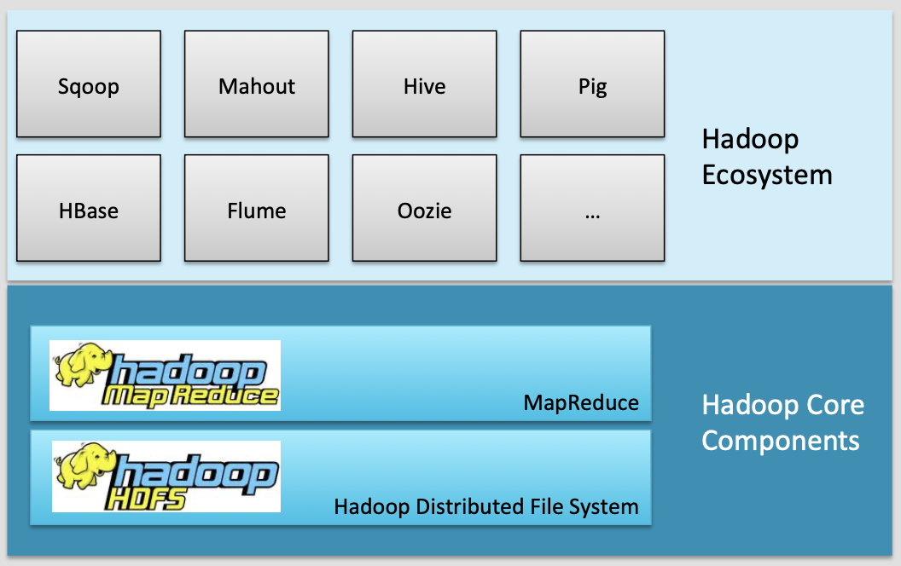
Hadoop Ecosystem

Slide 8
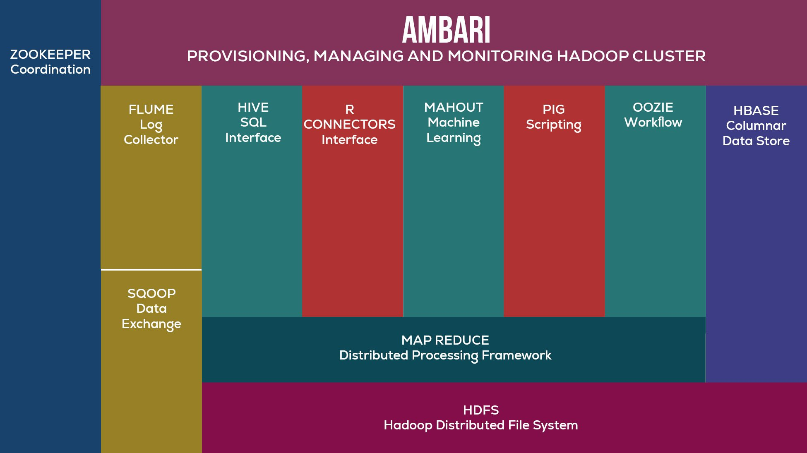
A more modern/up-to-date depiction of Hadoop Ecosystem
Image taken from https://www.analytixlabs.co.in/blog/prerequisite-for-hadoop/

Slide 9
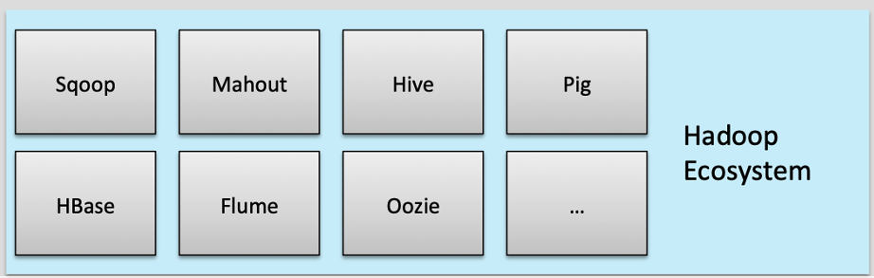
Hadoop Ecosystem
Ecosystem projects may be
Built on HDFS and MapReduce
Built on just HDFS
Designed to integrate with or support Hadoop
Most are Apache projects or Apache Incubator projects
Some others are not managed by the Apache Software Foundation
These are often hosted on GitHub or a similar repository
In other words, often Open-source projects/software!

Slide 10

Data Storage: HBase
HBase = Hadoop database
It is a ‘NoSQL’ datastore
Therefore no SQL access unless via other tools such as Apache Phoenix, Hive or Impala
It can store massive amounts of data
Petabytes or more
It runs on HDFS, providing Bigtable-like capabilities for Hadoop
Note: Bigtable is developed by Google, since 2004

Slide 11
HBase
High write throughput
Scales to hundreds of thousands of inserts per second
Handles sparse data well
No wasted spaces for empty columns in a row
Note: small amounts of information caught within a large collection of empty or unimportant data, such as finding the 50 largest items in a group of 2 billion records or finding the non-zero items representing less than 0.1% of a huge collection.
Limited access model
Optimized for lookup of a row by key rather than full queries
No transactions: single row operations only
Only one column (the ‘row key’) is indexed

Slide 12
HBase vs Traditional RDBMS
Data layout | Row-oriented | Column-oriented
Transactions | Yes | Single row only
Query language | SQL | Get/put/scan (or SQL via Phoenix, Hive or Impala)
Security | Authentication/ Authorization | Kerberos
Indexes | Any column | Row-key only
Max data size | TBs | PB+
Read/write throughput (queries per second) | Thousands | Millions

Slide 13


When to use HBase?
Use plain HDFS if...
You only append to your dataset (no random write)
You usually read the whole dataset (no random read)
Use HBase if...
You need random write and/or read
You do thousands of operations per second on TB+ of data
Use an RDBMS if...
Your data fits on one big node
You need full transaction support – You need real-Mme query capabilities

Slide 14

Data integration: Flume
What is Flume?
A service to move large amounts of data in real Mme – Example: storing log files in HDFS
Flume imports data into HDFS as it is generated – Instead of batch-processing it later
For example, log files from a Web server
Flume is
Distributed
Reliable and available
Horizontally scalable
Extensible

Slide 15
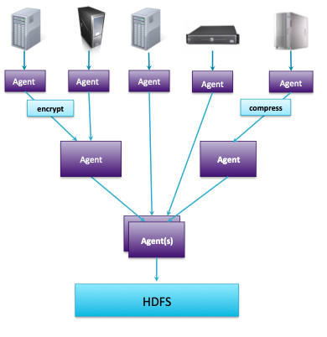
Flume: High-level Overview
Collect data as it is produced
Files, syslogs, stdout or custom source
Process in place
e.g., encrypt, compress
Pre-process data before storing
e.g., transform, scrub, enrich
Write in parallel
Scalable throughput
Store in any format
Text, compressed, binary, or custom sink

Slide 16

Data integration: Sqoop
Sqoop transfers data between RDBMSs and HDFS
Does this very efficiently via a Map-only MapReduce job
Supports JDBC, ODBC, and several specific databases
“Sqoop” = “SQL to Hadoop”
“retired” since 2021
Moved into Attic – means it is inactive
Still usable but no more support/further development
Alternative: Spark, Kafka (via JDBC-Connector)

Slide 17



Data Analysis: Hive, Pig, and Impala
Why Hive, Pig and Impala and not MapReduce?
Because - while powerful, MapReduce is hard to master
The solution: Ecosystem software to run on top of MapReduce

Slide 18
Hive, Pig
Hive and Pig
Languages for querying and manipulating data
Leverage existing skillsets
Data analysts who use SQL
Programmers who use scripting languages
Open-source Apache projects
Hive initially developed at Facebook
Pig Initially developed at Yahoo!
Interpreter runs on a client machine
Turns queries into MapReduce jobs
Submits jobs to the cluster

Slide 19
Hive, Pig
Hive
Uses HiveQL: An SQL-like interface to Hadoop
SELECT * FROM purchases WHERE price > 10000 ORDER BY storied
Pig
Uses Pig LaLn: A dataflow language for transforming large data sets
purchases = LOAD "/user/dave/purchases" AS (itemID,
price, storeID, purchaserID);
bigticket = FILTER purchases BY price > 10000;

Slide 20
Impala
High-performance SQL engine for vast amounts of data
Similar query language to HiveQL
10 to 50+ Mmes faster than Hive, Pig, or MapReduce
Impala runs on Hadoop clusters
Data stored in HDFS
Does not use MapReduce
Developed by Cloudera
100% open source, released under the Apache software license

Slide 21
Which one to choose?
Use Impala when...
You need near real-time responses to ad hoc queries – You have structured data with a defined schema
Use Hive or Pig when...
You need support for custom file types, complex data types, or external functions
Use Pig when...
You have developers experienced with writing scripts
Your data is unstructured/multi-structured
Use Hive When...
You have analysts familiar with SQL
You are integrating with BI or reporting tools via ODBC/JDBC (SQL-based software)

Slide 22

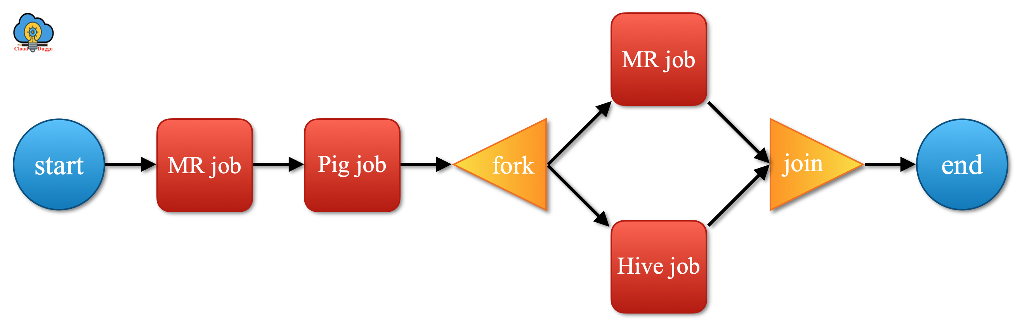
Workflow engine: Oozie
Oozie is a workflow engine for MapReduce jobs
Defines dependencies between jobs
Oozie is integrated with the rest of the Hadoop stack supporting several types of Hadoop jobs out of the box (such as Java map-reduce, Streaming map-reduce, Pig, Hive, Sqoop) as well as system specific jobs (such as Java programs and shell scripts).
The Oozie server submits the jobs to the server in the correct sequence
Oozie Workflow jobs are Directed Acyclical Graphs (DAGs) of action

Slide 23

How about Machine Learning: Mahout
Mahout is a Machine Learning library written in Java
Used for
Collaborative filtering (recommendations)
Clustering (finding naturally occurring “groupings” in data) – Classification (determining whether new data fits a category)
Why use Hadoop for Machine Learning?
“It’s not who has the best algorithms that wins. It’s who has the most data.”
But since 2014, support for MapReduce algorithms started being phased out
Machine learning in Big Data - Spark and Mahout (standalone or without Hadoop)
Today, it is more backend-independent – supports Spark and Scala for linear algebra and machine learning tasks
Some examples of usage - https://mahout.apache.org/documentation/tutorials/

Slide 24

Apache Ambari
Managing the whole ecosystem
Hadoop cluster provisioning
Step by step process for installing hadoop on many hosts
Handles Hadoop cluster configurations
Hadoop cluster management
Provides central management service for starting, stopping and re-configuring Hadoop services
Hadoop cluster monitoring
Dashboard for monitoring cluster health and status
Amber Alert framework for notifying if something is wrong

Slide 25

Apache Zookeeper!
An open-source server for highly reliable distributed coordination of cloud applications
It is a project of the Apache Software Foundation\
The server offers a service for distributed systems offering a hierarchical key-value store
which is used to provide a distributed configuration service, synchronization service, and naming registry for large distributed systems
In Haddop – it handles Hadoop job coordination
Coordination between different distributed Hadoop jobs/services
Manages things like addresses, start-up/shutdown, configurations

Slide 26



All in all : Hadoop Ecosystem
Many projects built on, and supporting, Hadoop
Several will be covered in detail later in the course
Other BDA software includes
Apache Spark (unified analytics engine for large-scale data processing)
Apache Kafka (distributed event store and stream-processing platform)
Apache Storm (distributed stream processing computation framework)

Slide 27
Hadoop Deployment Discussions

Slide 28
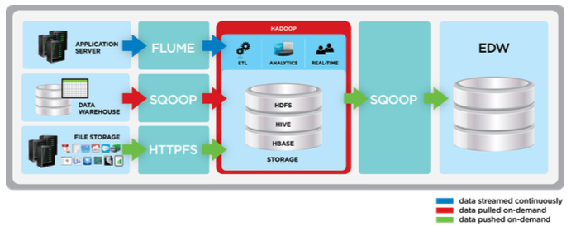
An example of Hadoop deployment in a data center
Image taken from CAP material, lesson 2

Slide 29
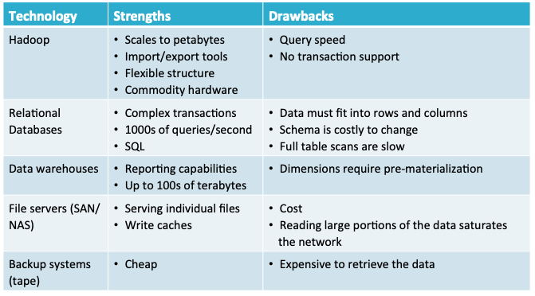
Technology Strengths and Weaknesses
Image taken from CAP material, lesson 2

Slide 30
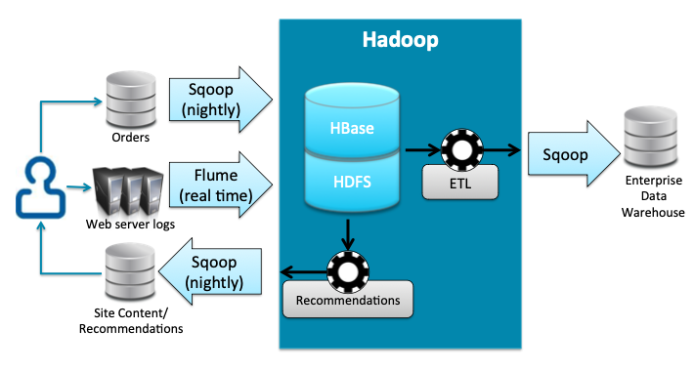
Example data flow
Image taken from CAP material, lesson 2

Slide 31
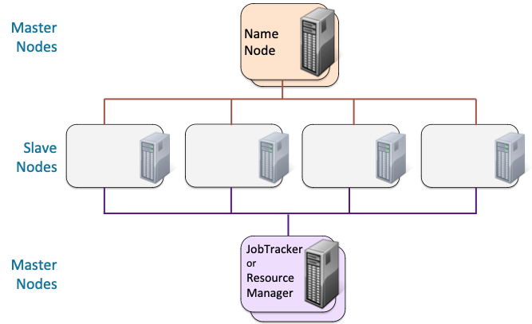
An example Hadoop cluster hardware setup
Image taken from CAP material, lesson 2

Slide 32
Hardware requirements
Recommended
Still possible…?
Processors
Mid-grade processors (e.g., 2 x 6-core 2.9 GHz)
Memory
48-96GB RAM
Network
1Gb Ethernet (mid-range) – 10Gb Ethernet (high-end)
Disk Drives
6 x 2TB drives per machine (mid-range)
12 x 3TB drives per machine (high-end)
Non-RAID
How about…
4-core CPU
8-16GB RAM
Network 1Gb Ethernet
100-500GB drives per machine
???

Slide 33
More importantly
Idealistically, four master nodes
2 NameNodes (one active and one standby)
2 ResourceManagers (in MRv1 then 2 Jobtrackers) (active and standby)
Each typically run on a separate machine
Use higher spec/quality servers for Master nodes
Carrier-class hardware
Dual power supplies, Ethernet cards – RAIDed hard drives
24GB RAM for clusters of 20 nodes or less
48GB RAM for clusters of up to 300 nodes
96GB RAM for larger clusters

Slide 34
With cloud computing
Scaling up (horizontally) is no longer that troublesome
Self-service imagine and replication
Automated/dynamic scaling based on load and needs
Pay-as-you-go model can help saving up more than on-premisses if additional resources are not always required.

Slide 35
More on MapReduce

Slide 36

Next… MapReduce (again?)
Let’s review what we learned about MapReduce so far….

Slide 37
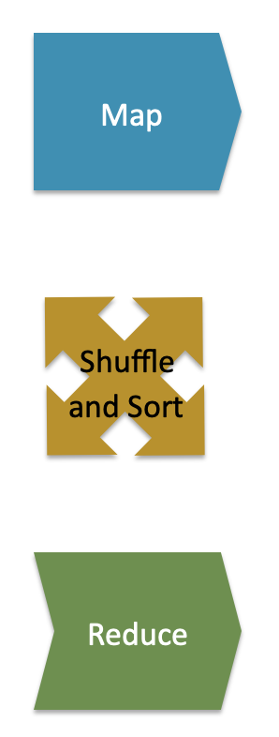
MapReduce consists of
The Mapper
Each Map task (typically) operates on a single HDFS block
Map tasks (usually) run on the node where the block is stored
Shuffle and Sort
Sorts and consolidates intermediate data from all mappers
Happens as Map tasks complete and before Reduce tasks start
The Reducer
Operates on shuffled/sorted intermediate data (Map task output)
Produces final output
Image taken from CAP material, lesson 1

Slide 38
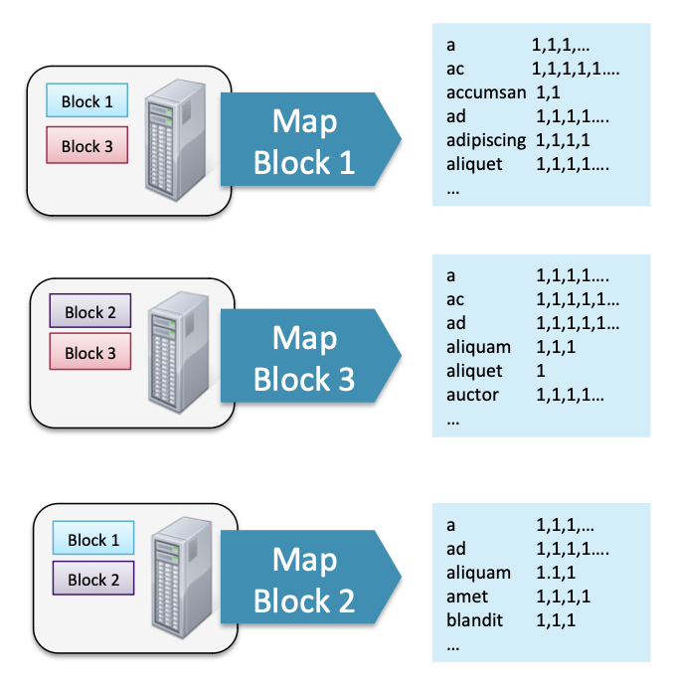
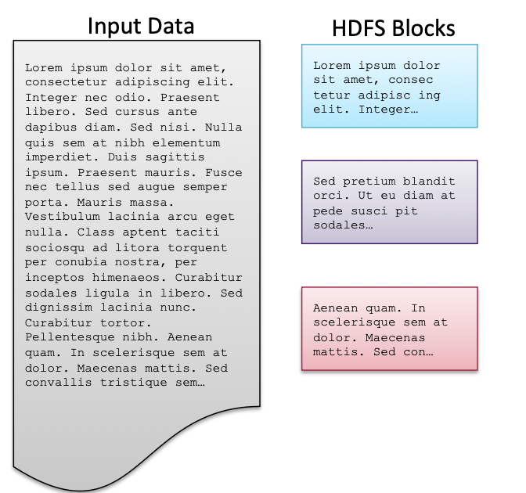
Power of MapReduce (and HDFS/Hadoop)
Hadoop runs Map tasks on the slave node where the block is stored (when possible)
Many Mappers can run in parallel
Minimizes network traffic
Image taken from CAP material, lesson 1

Slide 39
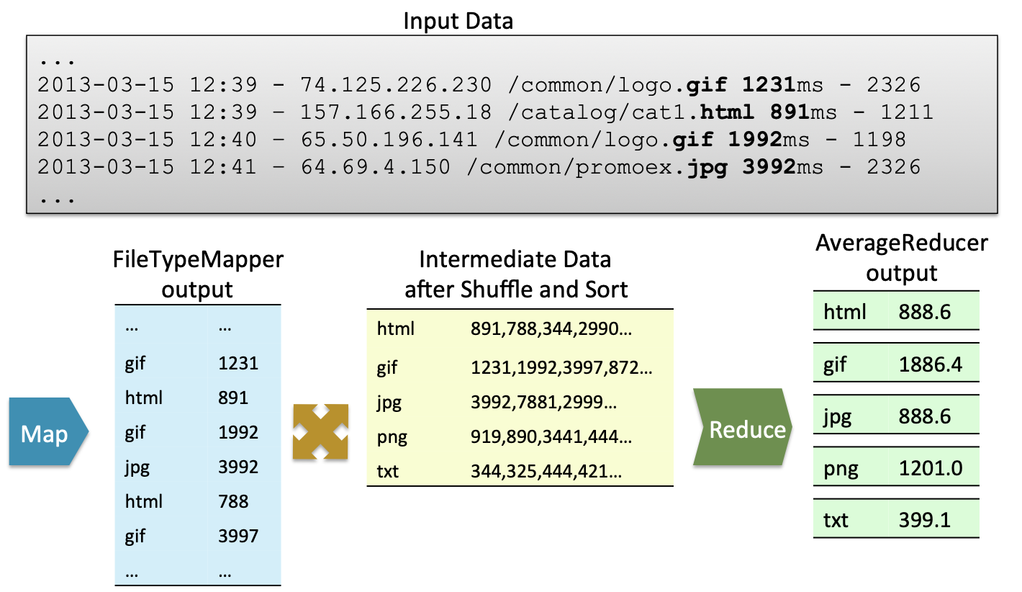
Another example: Analyzing Log Data
Image taken from CAP material, lesson 1

Slide 40
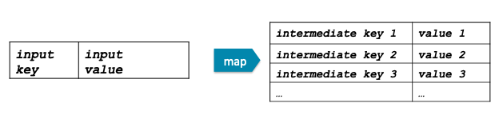
Example Mappers
The Mapper
Input: key/value pair
Output: A list of zero or more key value pair
map(in_key, in_value) → inter_key, inter_value) list

Slide 41
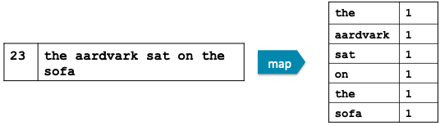
The mapper
The Mapper may use or completely ignore the input key
For example, a standard pa>ern is to read one line of a file at a Mme
The key is the byte offset into the file at which the line starts – The value is the contents of the line itself
Typically, the key is considered irrelevant
If the Mapper writes anything out, the output must be in the form of key/value pairs

Slide 42
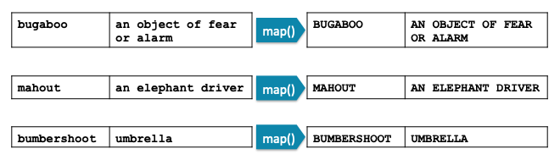
Example Mapper: Upper Case Mapper
Turn input into upper case (pseudo-code):
let map(k, v) = emit(k.toUpper(), v.toUpper())

Slide 43
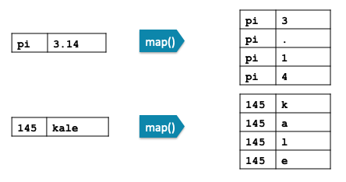
Example Mapper: ‘Explode’ Mapper
Output each input character separately (pseudo-code):
let map(k, v) = foreach char c in v:
emit (k, c)

Slide 44
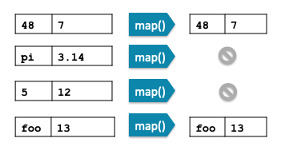
Example Mapper: ‘Filter’ Mapper
Only output key/value pairs where the input value is a prime number (pseudo-code):
let map(k, v) =
if (isPrime(v)) then emit(k, v)

Slide 45
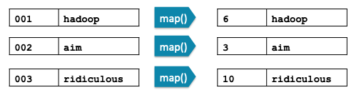
Example Mapper: Changing Keyspaces
The key output by the Mapper does not need to be identical to the input key
Example: output the word length as the key (pseudo-code):
let map(k, v) =
emit(v.length(), v)

Slide 46
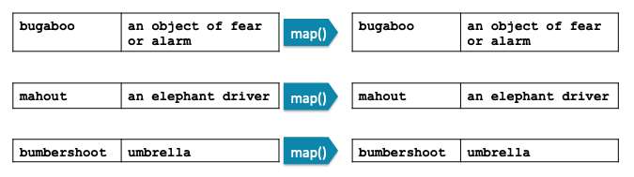
Example Mapper: Identity Mapper
Emit the key,value pair (pseudo-code):
let map(k, v) = emit(k, v)

Slide 47
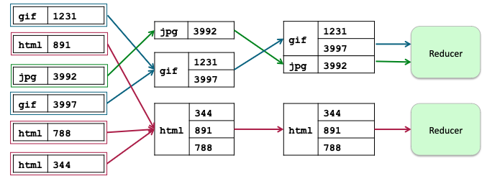
Reducers
After the Map phase is over, all intermediate values for a given intermediate key are grouped together
Each key and value list is passed to a Reducer
All values for a particular intermediate key go to the same Reducer
The intermediate keys/value lists are passed in sorted key order

Slide 48
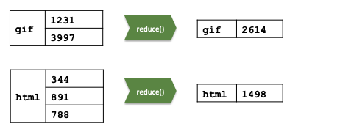
The Reducer
The Reducer outputs zero or more final key/value pairs
In practice, usually emits a single key/value pair for each input key
These are written to HDFS
reduce(inter_key, [v1, v2, ...]) →
(result_key, result_value)

Slide 49
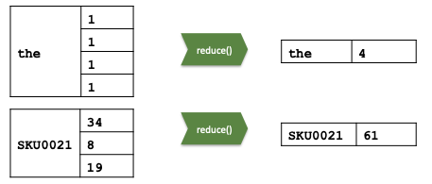
Example Reducer: Sum Reducer
Add up all the values associated with each intermediate key (pseudo- code):
let reduce(k, vals) =
sum = 0
foreach int i in vals:
sum += i
emit(k, sum)

Slide 50
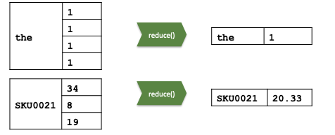
Example Reducer: Average Reducer
Find the mean of all the values associated with each intermediate key (pseudo-code):Lower Case Mapper
let reduce(k, vals) =
sum = 0; counter = 0;
foreach int i in vals:
sum += i; counter += 1;
emit(k, sum/counter)

Slide 51
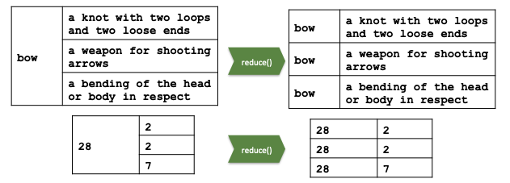
Example Reducer: Identity Reducer
The Identity Reducer is very common (pseudo-code):
let reduce(k, vals) =
foreach v in vals:
emit(k, v)

Slide 52
Key Points
A MapReduce program has two major developer-created components: a Mapper and a Reducer
Mappers map input data to intermediate key/value pairs
Often parse, filter, or transform the data
Reducers process Mapper output into final key/value pairs
Often aggregate data using statistical functions

Slide 53
Next class: Revisiting Hadoop cluster
See you!

